Slide 1
HTML 5 Hands On
By Rohit Ghatol
rohitsghatol@gmail.com

Slide 2
Topics
DocType, New Tags and New Form Elements
Audio, Video, Canvas and SVG
CSS 3 (Transition and Text Remaining)
Web Workers and Web Sockets
File System API and Drag and Drop
Geo, Device Orientation
Offline/Storage API
Chrome Frame

Slide 3
History of HTML and way to HTML 5

Slide 4
HTML 4.01

Slide 5
Web Technology = Innovation Vs Standards

Slide 6
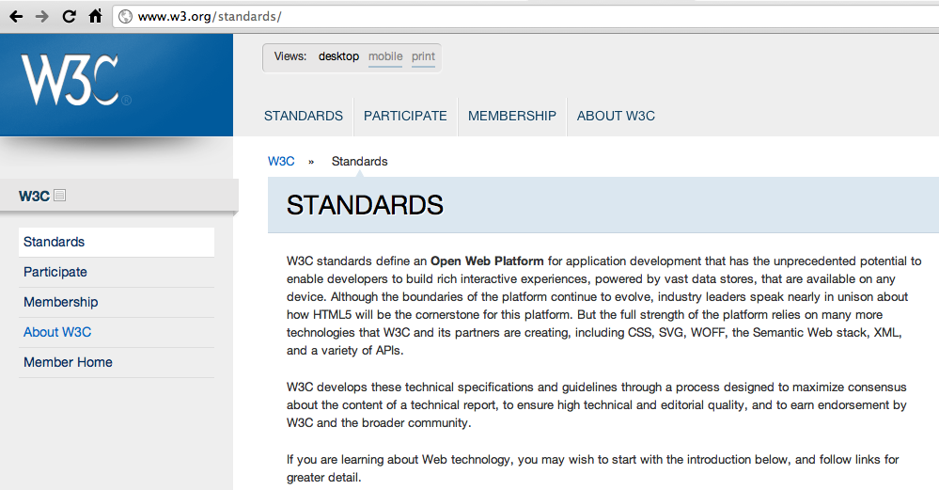
XHR
Window
Slow

Slide 7




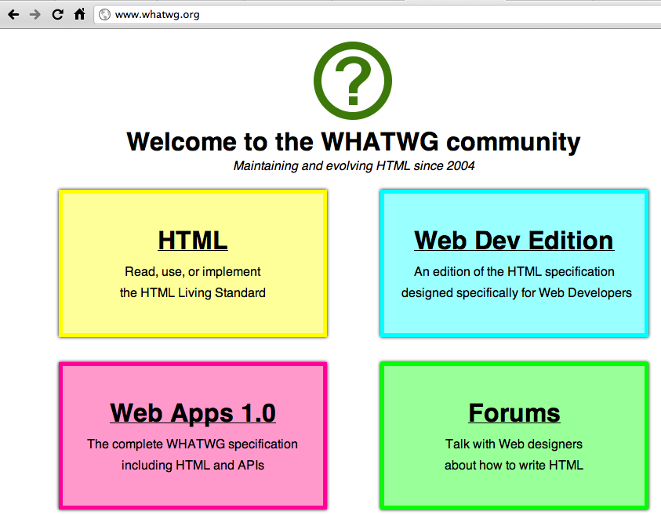

Slide 8
When will HTML 5 be ready?

Slide 9
Not in few years to come

Slide 10
HTML 5 Browser Compatibility

Slide 11
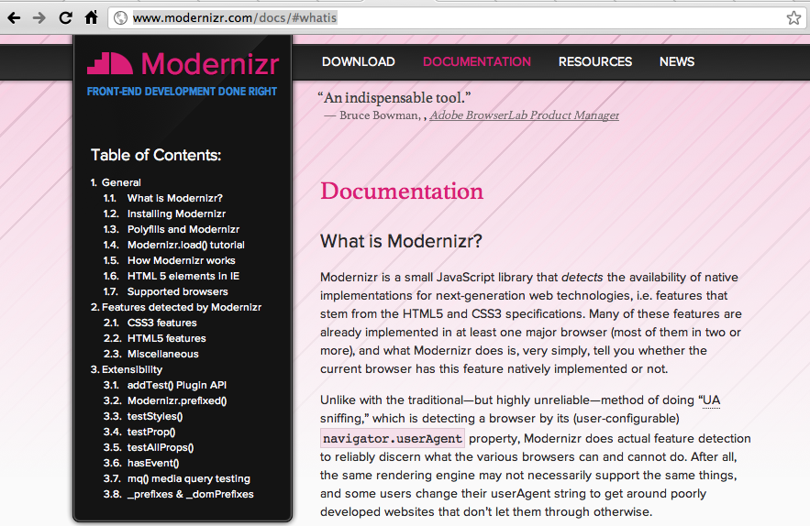

Slide 12
New DocType and Tags

Slide 13
<!DOCTYPE HTML PUBLIC "-//W3C//DTD HTML 4.01//EN"
"http://www.w3.org/TR/html4/strict.dtd">
<html lang="en">
<head>
<meta http-equiv="Content-Type" content="text/html;charset=utf-8">
<script type="text/javascript" src="js/app.js"></script>
<script type="text/javascript">
var data = {…}
</script>
<link type="text/css" rel="stylesheet" href="css/app.css" media="screen">
<title>HTML5</title>
</head>
<body>
</body>
</html>

Slide 14
<!DOCTYPE HTML PUBLIC "-//W3C//DTD HTML 4.01//EN"
"http://www.w3.org/TR/html4/strict.dtd">
<!DOCTYPE HTML>

Slide 15
<!DOCTYPE HTML PUBLIC "-//W3C//DTD HTML 4.01//EN"
"http://www.w3.org/TR/html4/strict.dtd">
<html lang="en">
<head>
<meta http-equiv="Content-Type" content="text/html;charset=utf-8">
<script type="text/javascript" src="js/app.js"></script>
<script type="text/javascript">
var data = {…}
</script>
<link type="text/css" rel="stylesheet" href="css/app.css" media="screen">
<title>HTML5</title>
</head>
<body>
</body>
</html>

Slide 16
<script type="text/javascript" src="js/app.js"></script>
<script src="js/app.js"></script>

Slide 17
<!DOCTYPE HTML PUBLIC "-//W3C//DTD HTML 4.01//EN"
"http://www.w3.org/TR/html4/strict.dtd">
<html lang="en">
<head>
<meta http-equiv="Content-Type" content="text/html;charset=utf-8">
<script type="text/javascript" src="js/app.js"></script>
<script type="text/javascript">
var data = {…}
</script>
<link type="text/css" rel="stylesheet" href="css/app.css" media="screen">
<title>HTML5</title>
</head>
<body>
</body>
</html>

Slide 18
<link type="text/css" rel="stylesheet" href="css/app.css" media="screen">
<link rel="stylesheet" href="css/app.css" media="screen">

Slide 19
<!DOCTYPE HTML PUBLIC "-//W3C//DTD HTML 4.01//EN"
"http://www.w3.org/TR/html4/strict.dtd">
<html lang="en">
<head>
<meta http-equiv="Content-Type" content="text/html;charset=utf-8">
<script type="text/javascript" src="js/app.js"></script>
<script type="text/javascript">
var data = {…}
</script>
<link type="text/css" rel="stylesheet" href="css/app.css" media="screen">
<title>HTML5</title>
</head>
<body>
</body>
</html>

Slide 20
<meta http-equiv="Content-Type" content="text/html;charset=utf-8">
<meta content="text/html;charset=utf-8">

Slide 21
Section, Article, Aside

Slide 22
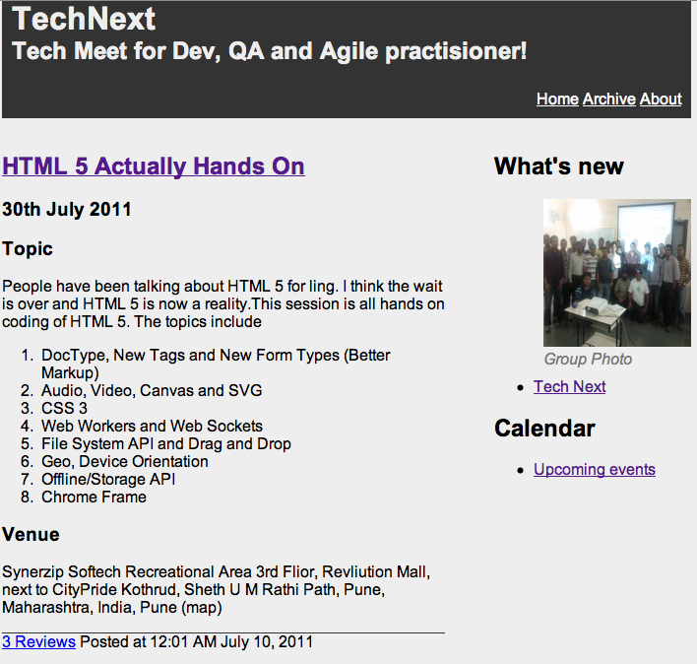

Slide 23
Div Hell
<body>
<div id="header">
<h1>TechNext</h1>
<h2>Tech Meet for Dev, QA and Agile practisioner!</h2>
<div id="navigation">
<ul>
<li><a href="/">Home</a></li>
<li><a href="/archive">Archive</a></li>
<li><a href="/about">About</a></li>
</ul>
</div>
</div>
<div id="meets">
<div class="meet">
<div class="headline">
<h2><a href="http://www.meetup.com/TechNext/events/21562131/">HTML 5 Actually Hands On</a></h2>
<h3>30th July 2011</h3>
</div>
<p>
<h3>Topic</h3>
<p>People have been talking about HTML 5 for ling. I think the wait is over and HTML 5 is now a reality.This session is all hands on coding of HTML 5. The topics include</p>
<ol>
<li>DocType, New Tags and New Form Types (Better Markup)</li>
<li>Audio, Video, Canvas and SVG</li>
<li>CSS 3</li>
<li>Web Workers and Web Sockets</li>
<li>File System API and Drag and Drop</li>
<li>Geo, Device Orientation </li>
<li>Offline/Storage API</li>
<li>Chrome Frame</li>
</ol>
</p>
<h3> Venue</h3>
<p>
Synerzip Softech Recreational Area
3rd Flior, Revliution Mall, next to CityPride Kothrud, Sheth U M Rathi Path, Pune, Maharashtra, India, Pune (map)
</p>
<div class="footer">
<a class="comments" href="/posts/1/comments">3 Reviews</a>
<span class="posted_at">Posted at 12:01 AM July 10, 2011</span>
</div>
</div>
<!-- More Posts...-->
<div class="meet">
<div class="headline">
<h2><a href="http://www.meetup.com/TechNext/events/20652031/">Digging Deeper into ORM and Hibernate</a></h2>
<h3>13th August 2011</h3>
</div>
<p>
<h3>Topic</h3>
<p>Although many of us have used Hibernate and JPA, our understanding of it is limited to its usage alone. This talk digs deeper into what ORM is and compares Hibernate framework Vs the JPA standard and their relationship. This talks also focuses on what can not be done using ORM and what are the best practices when it comes to using ORM</p>
<ol>
<li>ORM : What exactly it solves</li>
<li>Hibernate - Where it fits into picture</li>
<li>Hibernate vs JPA</li>
<li>Limitations of ORM </li>
<li>Good practices of using ORM in context of JPA and Hibernate</li>
</ol>
</p>
<h3> Venue</h3>
<p>
Synerzip Softech Recreational Area
3rd Flior, Revliution Mall, next to CityPride Kothrud, Sheth U M Rathi Path, Pune, Maharashtra, India, Pune (map)
</p>
<div class="footer">
<a class="comments" href="/posts/1/comments">3 Queries</a>
<span class="posted_at">Posted at 12:01 AM July 3, 2011</span>
</div>
</div>
</div>
<div id="sidebar">
<div id="bligrlil">
<h2>What's new</h2>
<div class="figure">
<img src="http://photos3.meetupstatic.com/photos/event/2/4/c/d/highres_40689421.jpeg">
<span class="caption">Group Photo</span>
</div>
<ul>
<li><a href="http://www.meetup.com/technext">Tech Next</a></li>
</ul>
</div>
<div id="calendar">
<h2>Calendar</h2>
<ul>
<li><a href="http://www.meetup.com/TechNext/#calendar">Upcoming events</a></li>
</ul>
</div>
</div>
<div id="footer">
&copy; 2011 <a href="http://www.meetup.com/technext">Tech Next </a>
</div>

Slide 24
What is Needed?
More Meaning to tags than just Divs

Slide 25
Header
Nav
Article
Header
Aside
Section
Figure
Section
Footer

Slide 26
New Form Elements

Slide 27
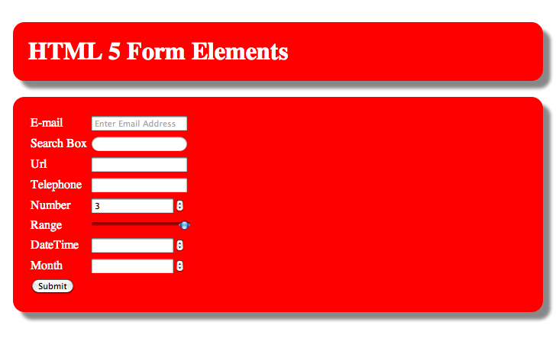

Slide 28
New HTML Form Elements
<input type="email" name="user_email" required placeholder="Enter Email Address"/>
<input type="search" />
<input type="url" name="url" required autofocus/>
<input type="tel" name="tel" required/>
<input type="number" name="number" min="1" max="5" step="1" value="3" required/>
<input type="range" name="range" min="1" max="5" step="1" value="3" required/>
<input type="datetime" name="datetime" required/>
<input type="month" name="month" required/>

Slide 29
Audio & Video Tags

Slide 30
Audio & Video Formats & Codecs

Slide 31
Formats
H 264 – MP4 Video
Codec
Theora – Ogg Video
Codec
WebM - .webm Video
Codec

Slide 32
Audio & Video Tags

Slide 33
Tags
<video width="320" height="240" controls>
<source src="pr6.mp4" type='video/mp4; codecs="avc1.42E01E, mp4a.40.2"'>
<source src="pr6.webm" type='video/webm; codecs="vp8, vorbis"'>
<source src="pr6.ogv" type='video/ogg; codecs="theora, vorbis"'>
</video>

Slide 34
Audio & Video Events

Slide 35
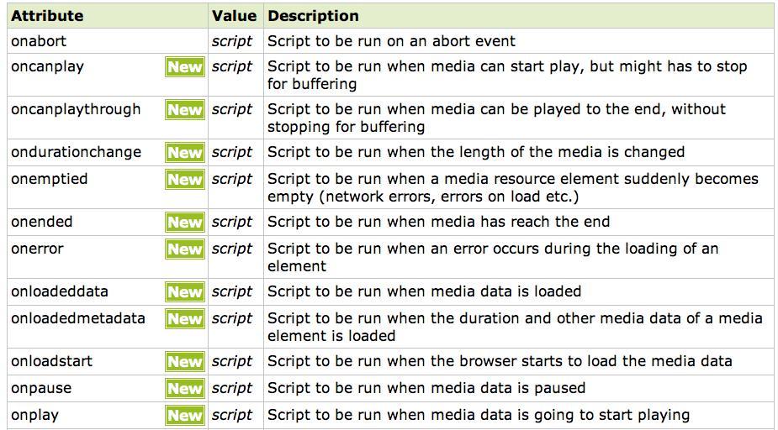
Media Events

Slide 36
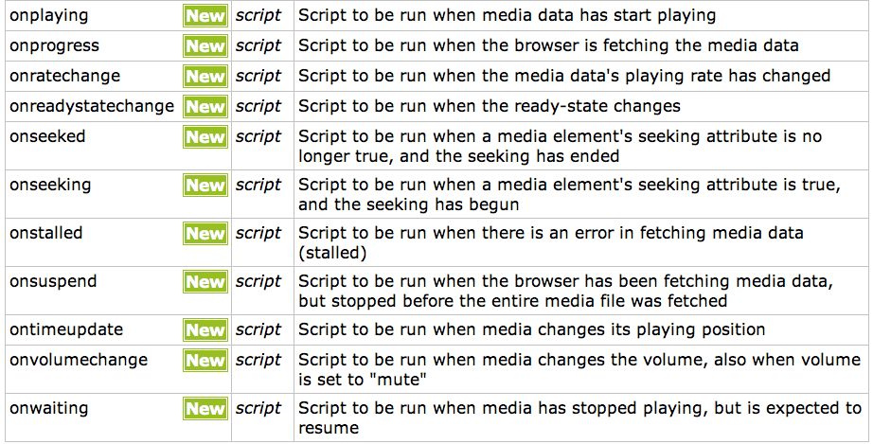
Media Events

Slide 37
Canvas & SVG

Slide 38
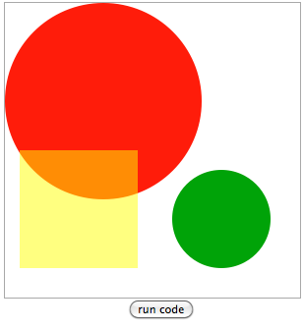
Canvas
<canvas id=“canvas” ></canvas>
var canvasElem = document.getElementById(“canvas”);
var ctx = canvasElem.getContext(‘2d’);
ctx.fillStyle = "#00A308";
ctx.beginPath();
ctx.arc(220, 220, 50, 0, Math.PI*2, true);
ctx.closePath();
ctx.fill();
ctx.fillStyle = "#FF1C0A";
ctx.beginPath();
ctx.arc(100, 100, 100, 0, Math.PI*2, true);
ctx.closePath();
ctx.fill();
//the rectangle is half transparent
ctx.fillStyle = "rgba(255, 255, 0, .5)"
ctx.beginPath();
ctx.rect(15, 150, 120, 120);
ctx.closePath();
ctx.fill();
http://billmill.org/static/canvastutorial/color.html

Slide 39
Drawing Capabilities
Drawing APIs
lineTo(),moveTo(),arcTo()
Transformation APIs
scale(), translate(), transform()
Context APIs
save()
restore()
https://developer.mozilla.org/en/DOM/CanvasRenderingContext2D

Slide 40
Drawing Concepts
Drawing by calculating everything yourself
Drawing using Transformation

Slide 41
Example
0,0
What is x,y?
@ 45 Degree
200,200
300,200
300,200
@ 84%

Slide 42
Psuedo Code
0,0
ctx.save();
ctx.rect(0,0,200,200);
ctx.restore();
ctx.save();
ctx.translate(200,200);
ctx.rect(0,0,200,200);
Ctx.save();
200,200

Slide 43
Psuedo Code
ctx.save();
ctx.translate(300,200);
ctx.rotate(…);
ctx.rect(0,0,200,200);
ctx.restore();
ctx.save();
ctx.translate(200,200);
ctx.translate(300,200);
ctx.scale(…,…);
ctx.rotate(…);
ctx.rect(0,0,200,200);
Ctx.save();
@ 45 Degree
300,200
300,200
@ 84%

Slide 44
Game Concept
setInterval(gameLoop,100);
function gameLoop(){
manipulateModel();
clearCanvas();
drawModel();
}

Slide 45
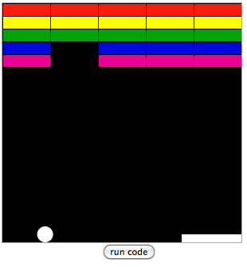
Brick Game
http://billmill.org/static/canvastutorial/index.html

Slide 46
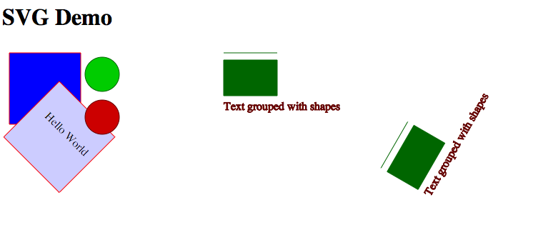
SVG
http://tutorials.jenkov.com/svg/index.html

Slide 47
CSS 3

Slide 48
CSS 3 Border Radius

Slide 49
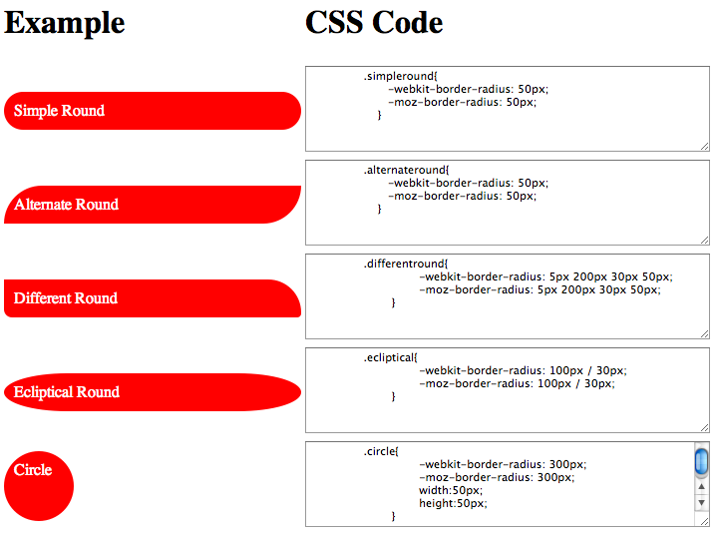

Slide 50
CSS 3 Box Shadow

Slide 51
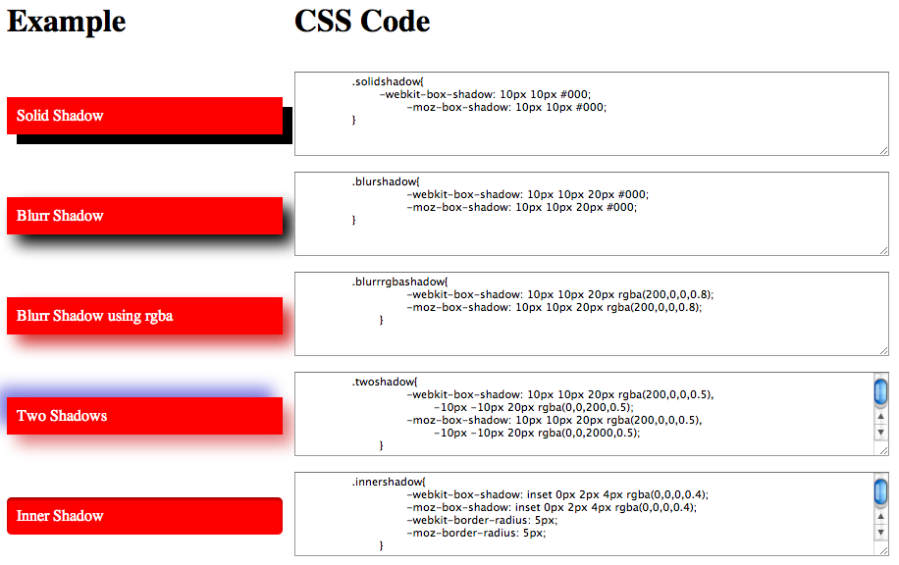

Slide 52
CSS 3 Gradients

Slide 53
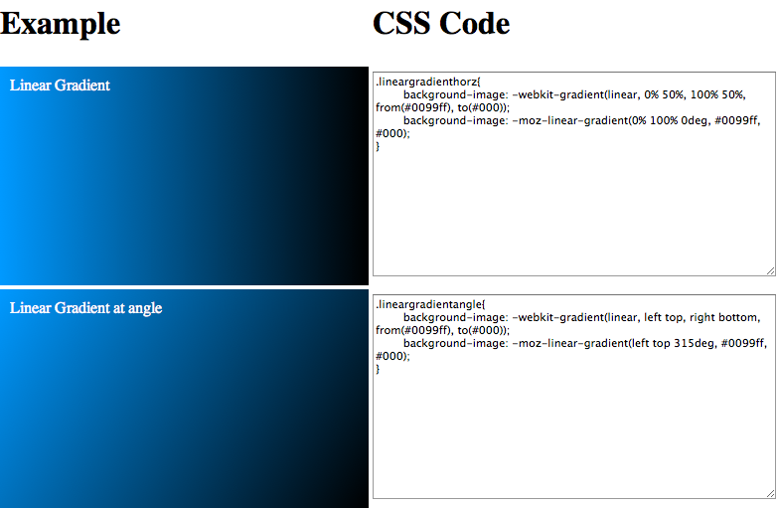

Slide 54
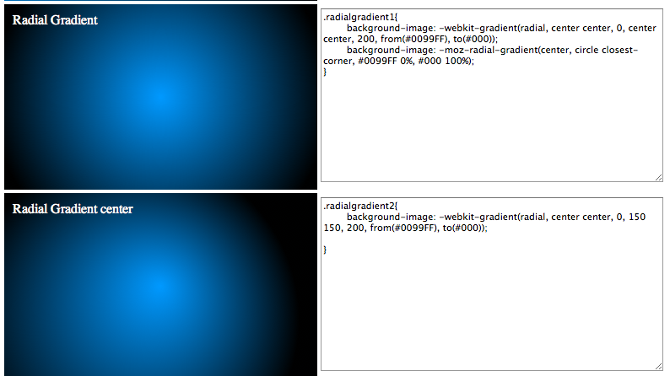

Slide 55
CSS3 Animations
Step 1 – CSS Transform 2D
Step 2 – CSS Transform 3D
Step 3 – CSS Transition (Smoothing out)
Step 4 – CSS Animation (key frames)

Slide 56
CSS 3 Transformation 2D Transforms and 3D Transforms

Slide 57
Transforms
-webkit-transform: translate(x,y);
-webkit-transform: scale(xScale,yScale);
-webkit-perspective: distance;
-webkit-transform:translate3d(x,y,z);
-webkit-transform:scale3d(xScale,yScale,zScale)
-webkit-transform:rotate3d(xAng,yAng,zAng);

Slide 58
CSS 3 Transitions

Slide 59
CSS 3 Animations

Slide 60
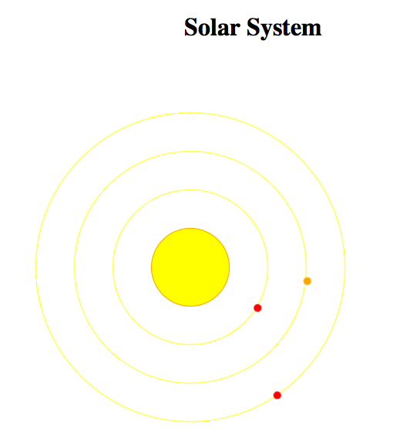

Slide 61
WebWorker

Slide 62
WebWorker
//From HTML Side
var worker = new Worker(“some.js”);
worker.addEventListener(“message”,function(e){
var data = e.data;
});
worker.postMessage(data);

Slide 63
WebWorker
//From Worker JavaScript side
addEventListener(“message”,function(e){
//receive command from html
var data = e.data;
});
//inform html about result
postMessage(data);

Slide 64
HTML Page
Worker Javascript
Variables
XHR
DOM
XHR
CSS
postMessage()
Event message
Event message
postMessage()
Web Page Context
Separate Javascript Context

Slide 65
File System and Drag and Drop

Slide 66
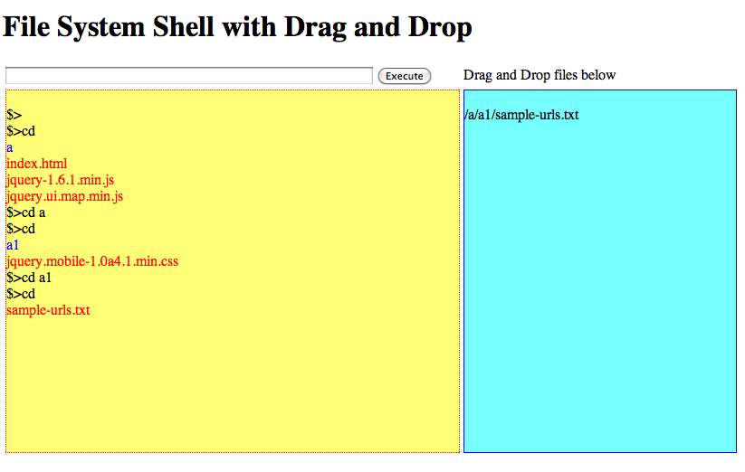

Slide 67
Required Setup
Chrome 12
Start with command prompt
--unlimited-quota-for-files
--allow-file-access-from-files

Slide 68
File System Setup
var fileSys
function onInitFs(fs){
fileSys=fs;
}
function errorHandler(err){
alert(err.code);
}
window.webkitRequestFileSystem(window.PERSISTENT, 5242880, onInitFs, errorHandler);
http://www.html5rocks.com/en/tutorials/file/filesystem/

Slide 69
Get Directory Entry
Function successCallback(dirEntry){
}
function errorHandler(err){
alert(err.code);
}
fileSys.root.getDirectory(dirPath,{},successCallback,errorHandler);
http://www.html5rocks.com/en/tutorials/file/filesystem/

Slide 70
Create Directory Entry
Function successCallback(dirEntry){
}
function errorHandler(err){
alert(err.code);
}
fileSys.root.getDirectory(dirPath,{create:true},successCallback,errorHandler);
http://www.html5rocks.com/en/tutorials/file/filesystem/

Slide 71
Read Directory Entries
function listFiles(entries){
}
dirReader = dirEntry.createReader();
dirReader.readEntries(listFiles,
errorHandler);
http://www.html5rocks.com/en/tutorials/file/filesystem/

Slide 72
Drag and Drop
<div id="commandHistory" ></div>
var dropbox = document.getElementById(“commandHistory”);
dropbox.addEventListener("dragenter", dragEnter, false);
dropbox.addEventListener("dragexit", dragExit, false);
dropbox.addEventListener("dragover", dragOver, false);
dropbox.addEventListener("drop", drop, true);

Slide 73
Drag and Drop
function drop(event){
if(event.dataTransfer.files){
var files = event.dataTransfer.files;
for(var index=0;index<files.length;index++){
var file = files[index];
alert(“name=“+file.name);
}
}
}

Slide 74
Read File
var reader = new FileReader();
// init the reader event handlers
reader.onloadend = function(event){
alert(“data=“+event.target.result);
}
// begin the read operation
reader.readAsDataURL(files[index]);

Slide 75
Write File
fileSys.root.getFile(fileName, {create: true},
function(fileEntry) {
//Now we got handle to file, lets write
},
errorHandler);

Slide 76
Write File
fileEntry.createWriter(
function(fileWriter) {
fileWriter.onwriteend = function(e) {
logDnd(fileName);
};
fileWriter.onerror = function(e) {
console.log('Write failed: ' + e.toString());
};
// Create a new Blob and write it to log.txt.
var bb = new window.WebKitBlobBuilder();
bb.append(event.target.result);
fileWriter.write(bb.getBlob('text/plain'));
},
errorHandler
);

Slide 77
Read more about File System
http://www.html5rocks.com/en/tutorials/file/filesystem/

Slide 78
Geo

Slide 79
Geo Demo
function success(position){
alert(“lat=“+position.coords.latitude);
alert(“lng=“+position.coords.longitude);
}
if (navigator.geolocation) {
navigator.geolocation.getCurrentPosition(success, error);
} else {
error('not supported');
}

Slide 80
Device Orientation

Slide 81
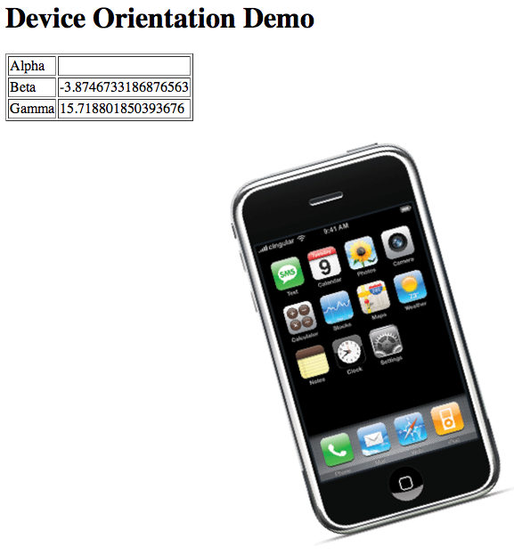
Device Orientation Demo

Slide 82
Device Orientation Demo
var iphone = document.getElementById("iphone");
window.addEventListener("deviceorientation",function(event){
document.getElementById("alpha").innerHTML = event.alpha;
document.getElementById("beta").innerHTML = event.beta;
document.getElementById("gamma").innerHTML = event.gamma;
var rotate = 'rotate(' + event.gamma*-1 + 'deg)';
var scale = 'scale(' + ((event.beta/180)*2 + 1) + ')';
iphone.style.webkitTransform = rotate + ' ' + scale;
});
http://www.jeremyselier.com/s/demo/device_orientation.html

